Slide 1

Incorporating
Healthy Homes into Inspections March 27, 2013
Jane Malone

Slide 2
Premise
We want to equip/empower agencies/organizations that inspect rental homes (or visit) to check for housing-related health hazards.

Slide 3
Inspection Policy Landscape
Local or state code(s)
Housing, sanitary, or health code
International Property Maintenance Code (IPMC)
Source - International Code Council (ICC)
Public nuisance law
Federal standards
HUD Housing Quality Standards (HQS)
Uniform Property Condition Standards (UPCS)
Minimum Property Standards (MPS)
Notes:
An extant policy is assumed.
If none, strategy #1 is enact a policy.

Slide 4
Strategies
Train inspectors
Add requirements to current codes
Leverage complaint-based enforcement
Proactive inspection
Expand inspection capacity
Redistribute roles/reorganize roles
Train home visitors
Expand model codes

Slide 5
1. Train inspectors
Ask local or state agency to host training
Engage ICC chapter to host/promote
Organize CEU credit
Enact requirement policy
Use NCHH training resources
Essentials for Healthy Homes Practitioners
Code Inspector
Educate them about renovation regulation

Slide 6
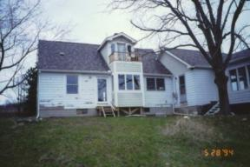
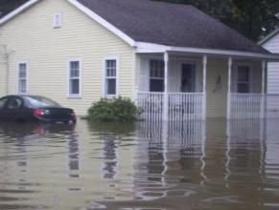
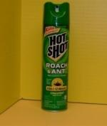
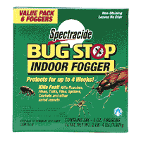
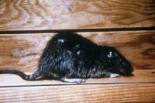
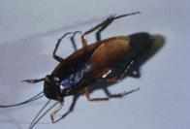
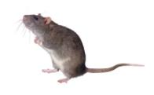
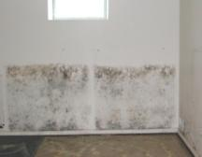


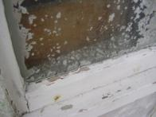
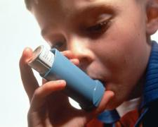




Example of a Training Tool: Why a Holistic Approach?
Structural Damage
Structural Damage
Moisture
Mold
Asthma Exacerbation

Slide 7
2. Add requirements
Organize/mobilize support
Leverage local knowledge
Content sources
Other jurisdictions
Use NCHH’s code change proposals
National Healthy Housing Standard
Multnomah County Healthy Homes Policy Toolkit

Slide 8
Key Provisions
Structural integrity
Weatherproof
Maintained
Cracks & holes
Loose/rotting material
Infestation, bedbugs
Sewer gas
Radon
Sanitation & trash
Dampness, mold, deterioration
Heating stove/CO
Ventilation from windows/fans
Cleanable surfaces
Clothes dryer vented

Slide 9
3. Leverage complaint-based enforcement
Most prevalent type of system
Encourage and support complaints
Inspectors can look for other problems
Effective model: Breathe Easy (Boston)
Risky for tenants to initiate agency contact
Landlord retaliation
Undocumented status

Slide 10
Boston’s Breathe Easy at Home Program
Providers can request inspection online
If they suspect substandard housing conditions are triggering child's asthma
Expedite inspections (initial & follow-up)
Collaborative program includes:
Inspectional Services Department (City)
Boston Medical Center (Boston University)
Boston Public Health Commission (City)
NGOs

Slide 11
4. Proactive inspections
Establish requirement to inspect the entire housing stock of
Los Angeles SCEP
Greensboro RUCO
Inspect all homes in target area
Baltimore’s Vacant to Value Program
Require turnover inspection
Certificate of occupancy tied to lease period

Slide 12
5. Expand inspection capacity
Add inspectors
Fund inspectors
Community development block grant (CDBG)
Fees on all rental housing
Re-inspection fees
Add specialized staff
Spanish/other language speaker
Healthy homes specialist (NCHH-NEHA)

Slide 13
6. Redistribute roles/reorganize
Tradition: health (county) & housing (city)
Move health inspection to housing agency
Indianapolis – Marion County
Allow housing agency to enforce health
CA – SB 460 for lead (pest management bill)
Interagency agreements
Merger of housing/health departments

Slide 14
7. Train home visitors
Maternal Infant and Early Childhood Home Visiting Program, other home visits
Certified community health workers and promotoras de salud
Preventive visits before/after birth
Emergency personnel
School/truancy staff

Slide 15
8. Expand model codes
International Code Council codes
NCHH progress
2013 efforts
Need for grassroots support
Connect with ICC Chapters

Slide 16
Impact of ICC’s Model Codes
Code | State-Wide As Published by ICC | State-Wide with Modifications | Local Use Only | Total
Building Code (IBC) | 35 | 12 | 3 | 50
Residential Code (IRC) | 33 | 8 | 8 | 49
Mechanical Code (IMC) | 29 | 9 | 8 | 46
Plumbing (IPC) | 20 | 4 | 13 | 37
Property Maint. (IPMC) | 6 | 4 | 29 | 39
Existing Building (IEBC) | 17 | 6 | 16 | 39

Slide 17
Past Successes with ICC Codes
IPMC
Pests - delete fumigation & spraying, prohibit water sources, clarify owner role
Vent dryer to outside the structure
Prohibit unvented space heater for heat
IRC
Require formaldehyde-free flooring
Carbon Monoxide Alarms

Slide 18
ICC Code Change Process - 2013
Jan. 3: Code Change Proposals due
Mar. 11: Code Change Proposals published online
Apr. 21-30: ICC Committee Action Hearings (Dallas)
June 21: Public “Comments” - prior proposals only
Aug. 28: Public Comments published online
Oct. 2-9: Final Action Hearings (Atlantic City)

Slide 19
IPMC Proposals - 2013
Lead-safe work practices in paint repair*
Pre-1978 – EPA RRP (interior and exterior)
Carbon monoxide (CO) alarms*
Fuel-fired appliance or attached garage
Moist building material - repair underlying cause
Define infestation to include specific pests
New definition of sanitary
Environmental safety appendix (standards)
*2009 committee accepted; rejected at final action hearing

Slide 20
IRC & IEBC Proposals - 2013
Lead Renovation (IEBC + IRC)
Require RRP compliance
Evidence of RRP compliance in construction docs
Enforce compliance with all federal/state rules
Cleanup of moldy materials (IEBC)
Require CO alarms (IEBC – already in IRC)
Radon-resistant new construction (IRC)

Slide 21
www.iccsafe.org
Regional and state chapters
http://www.iccsafe.org/gr/Pages/gr-map.aspx
Code development cycle
http://www.iccsafe.org/cs/codes/Pages/cycle.aspx
Code change process: Council Policy 28-05
I-codes: http://publicecodes.cyberregs.com/

Slide 22
Resources
Multnomah County Healthy Homes Policy Toolkit: http://web.multco.us/sites/default/files/health/documents/healthyhomespolicytoolkit.pdf
Boston Breathe Easy Program: http://www.cityofboston.gov/isd/housing/bmc.asp
Los Angeles Systematic Code Enforcement Program: http://lahd.lacity.org/lahdinternet/CEUSCEP/tabid/395/language/en-US/Default.aspx
Greensboro Rental Certificate of Occupancy: http://greensborohousingcoalition.com/what-we-do/renting-in-greensboro/
Baltimore’s Vacants to Values: http://www.baltimorehousing.org/vacants_to_value.aspx

Slide 23
Questions and Discussion

